Slide 1
Java
Cristian Camilo Cadavid E.
Luis Daniel Quintero Orjuela.
Sebastián Velasquez Rendón

Slide 2
Java, history and essential characteristics

Slide 3
What’s Java ?

Slide 4
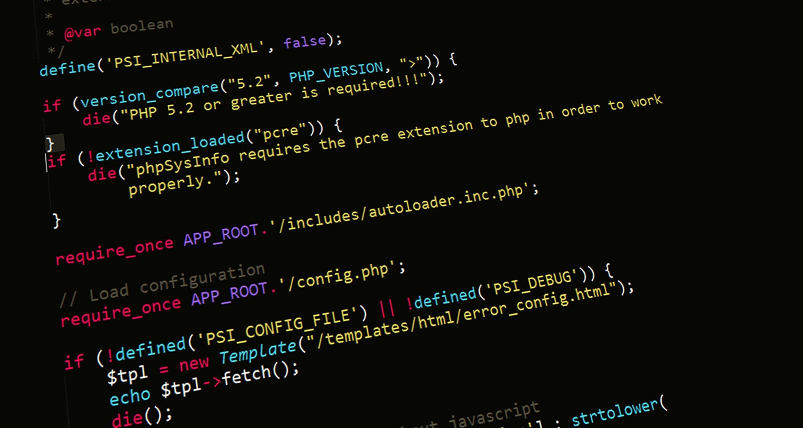
Java
1
Definition
Java is a general-purpose, concurrent, object-oriented programming language that was designed specifically to have as few implementation dependencies as possible.

Slide 5
How does it work?

Slide 6
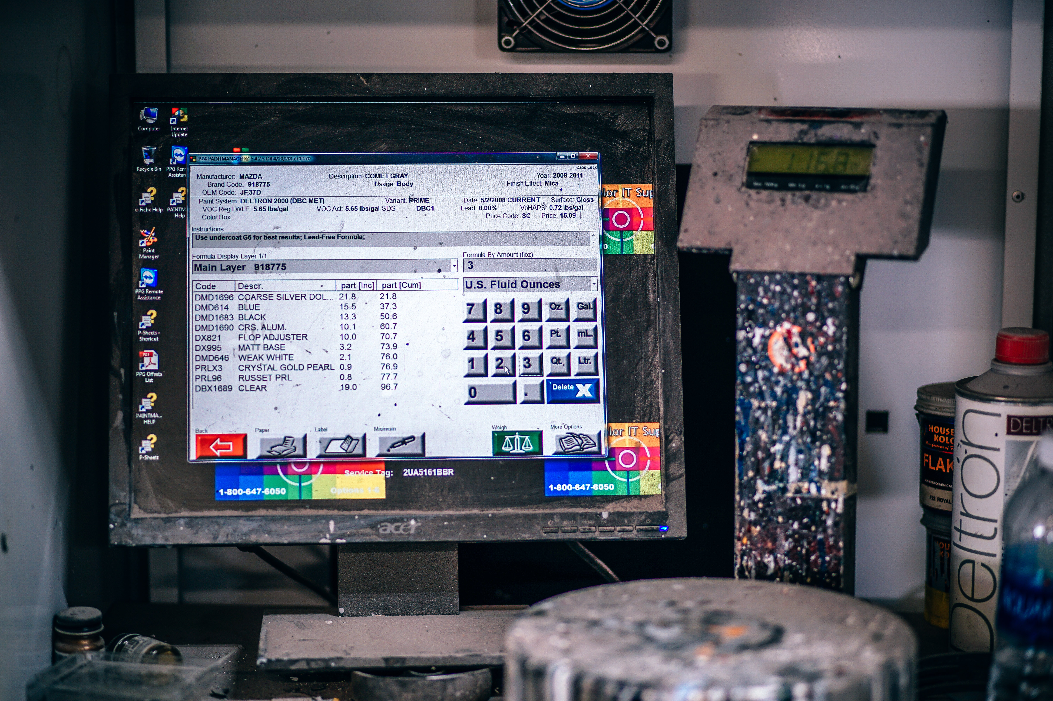
Java
2
Operation
It is a semi-compiled language that runs through its own virtual machine the Java Virtual Machine (JVM) so that the program can be read and interpreted by our computer.

Slide 7
Basic example

Slide 8
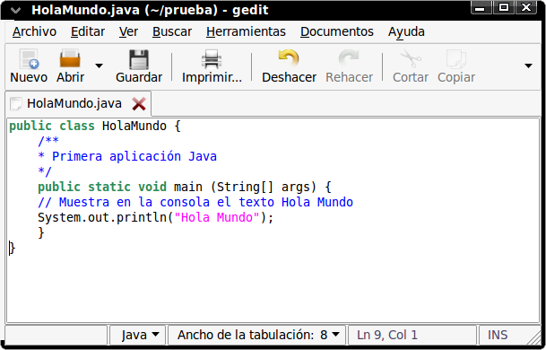
Java
3
Example

Slide 9
Computer graphics

Slide 10
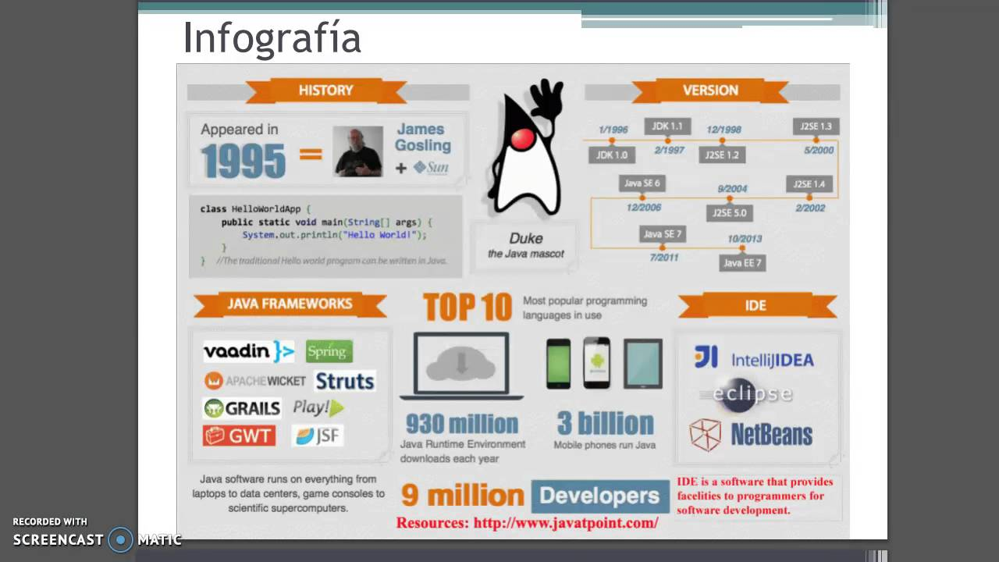
Java
3
infographic

